Slide 1
2:1-11

Slide 2
2:1-11
1 John 1:9-10 ~ ⁹ If we confess our sins, He is faithful and just to forgive us our sins and to cleanse us from all unrighteousness. ¹⁰ If we say that we have not sinned, we make Him a liar, and His word is not in us.

Slide 3
2:1-11

Slide 4
2:1-11
1 John “Wordle”

Slide 5
2:1-11

Slide 6
2:1-11
Little children ~ 9x in 1 John
4 reasons John wrote 1 John
1:4 ~ … these things we write to you that your joy may be full.
2:1 ~ … these things I write to you, so that you may not sin.
2:1 ~ … these things I write to you, so that you may not sin.
2:26 ~ These things I have written to you concerning those who try to deceive you.
5:13 ~ These things I have written to you … that you may know that you have eternal life,

Slide 7
2:1-11

Slide 8
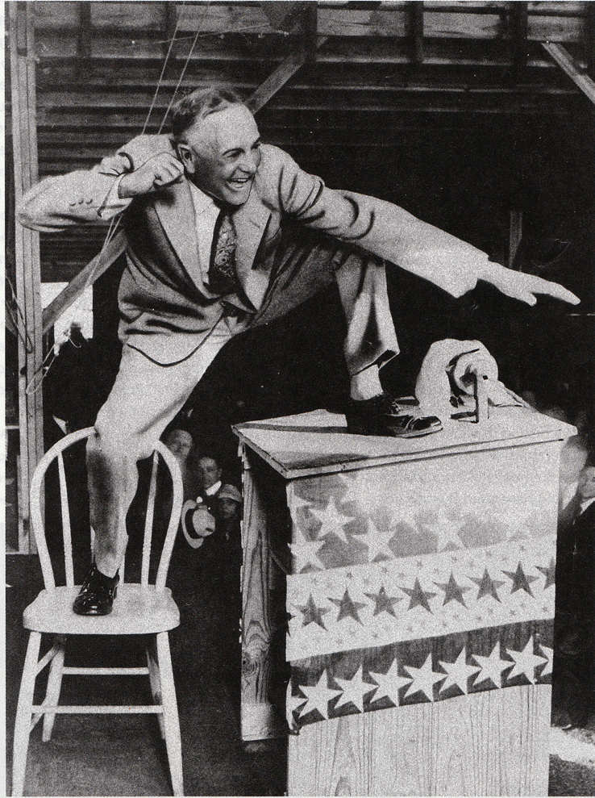
2:1-11
“I’m against sin. I’ll kick it as long as I’ve got a foot, and I’ll fight it as long as I’ve got a fist. I’ll butt it as long as I’ve got a head. I I’ll bite it as long as I’ve got a tooth.
Billy Sunday (1862-1935) ~
And when I’m old and fistless and footless and toothless, I’ll gum it till I go home to Glory and it goes home to perdition!”

Slide 9
2:1-11

Slide 10
2:1-11
Advocate ~ paraklētos – 4x in Gospel of John
Always translated Helper

Slide 11
2:1-11
You are in fhe flesh
I am righteously indignant
You are vain and conceited
I have self-respect
You are too lazy
I am too busy
You are contentious
I have convictions
You are divisive
I am standing up for what is right
You are carnal
I am free in Christ
Your heart is deceitfully wicked
My heart is …

Slide 12
2:1-11

Slide 13
2:1-11
Propitiation ~ hilasmos – appeasement
Literally, satisfaction

Slide 14
2:1-11

Slide 15
2:1-11
Know ~ ginōskō – to know by experience
21x in 1 John
Wuest ~ And in this we know experientially that we have come to know Him experientially and are in that state at present, if we are continually having a solicitous, watchful care in safeguarding His precepts by obeying them.

Slide 16
2:1-11

Slide 17
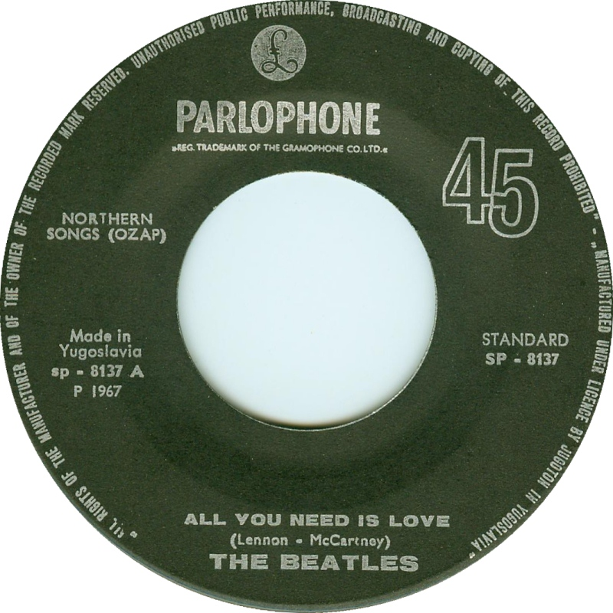
2:1-11
Love ~ agapaō – 30x; agapē – 16x in 1 John

Slide 18
2:1-11

Slide 19
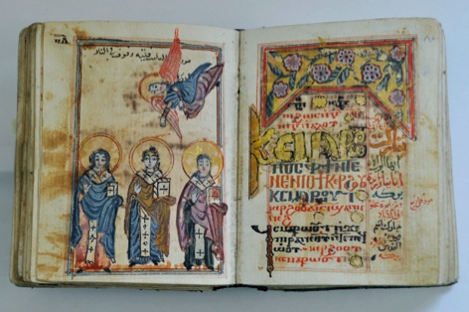
2:1-11
Phil. 3:9-10 ~ ⁹ … be found in Him, not having my own righteousness, which is from the law, but that which is through faith in Christ, the righteousness which is from God by faith; ¹⁰ that I may know Him and the power of His resurrection, and the fellowship of His sufferings, being conformed to His death,
Coptic Synaxarium
“Beloved, love one another”

Slide 20
2:1-11

Slide 21
2:1-11
Stumbling (v. 10) ~ skandalon ~ scandal
Know ~ eidō – to know intuitively (17x in 1 John)

Slide 22
2:1-11

